Slide 1


Slide 2
Business Analytics – The Science of Data Driven Decision Making
CHAPTER 2
U Dinesh Kumar

Slide 3
Introduction To Descriptive Analytics
🞂​ Simple comprehension of data using data summarization
🞂​ Basic statistical measures and visualization.
🞂​ Designing effective dashboards and scorecards.

Slide 4
Structured and Unstructured Data
🞂​ Structured data means that the data is described in a matrix
form with labelled rows and columns.
🞂​ Any data that is not originally in the matrix form with rows and columns is an unstructured data. Data such as texts, images, audio files, video files are unstructured data.

Slide 5
Structured data consisting of nominal and ratio scales
No. | Gender | Age | Percentage SSC | Board SSC | Percentage HSC | Percentage Degree | Salary
1 | M | 23 | 62 | Others | 88 | 52 | 270000
2 | M | 21 | 76.33 | ICSE | 75.33 | 75.48 | 220000
3 | M | 22 | 72 | Others | 78 | 66.63 | 240000
4 | M | 22 | 60 | CBSE | 63 | 58 | 250000
5 | M | 22 | 61 | CBSE | 55 | 54 | 180000
6 | M | 23 | 55 | ICSE | 64 | 50 | 300000
7 | F | 24 | 70 | Others | 54 | 65 | 240000
8 | M | 22 | 68 | ICSE | 77 | 72.5 | 235000
9 | M | 24 | 82.8 | CBSE | 70.6 | 69.3 | 425000
10 | F | 23 | 59 | CBSE | 74 | 59 | 240000

Slide 6
Unstructured data (sample clickstream data)
https://en.wikipedia.org/wiki/Clickstream
http://hortonworks.com/hadoop-tutorial/how-to-visualize-website-
clickstream-data/
http://searchcrm.techtarget.com/definition/clickstream-analysis
https://www.qubole.com/blog/big-data/clickstream-data-analysis/

Slide 7
Data Type
🞂​ Cross-Sectional Data: A data collected on many variables of interest at the same time or duration of time.
🞂​ Time Series Data: A data collected for a single variable such as demand for smartphones collected over several time intervals (weekly, monthly, etc.).
🞂​ Panel Data: Data collected on several variables (multiple dimensions) over several time intervals is called panel data (also known as longitudinal data).

Slide 8
TYPES OF VARIABLE MEASUREMENT SCALES
🞂​ Nominal scale refers to variables that are basically names (qualitative data) and also known as categorical variables.
🞂​ Ordinal scale is a variable in which the value of the data is captured from an ordered set, which is recorded in the order of magnitude.
🞂​ Interval scale corresponds to a variable in which the value is chosen from an interval set. Variable such as temperature measured in centigrade) or intelligence quotient (IQ) score are examples of interval scale
🞂​ Ratio Scale: Any variable for which the ratios can be computed and are meaningful is called ratio scale.

Slide 9
Population And Sample
🞂​Population is the set of all possible observations (often called cases, records, subjects or data points) for a given context of the problem.
🞂​ Sample is the subset taken from a population.

Slide 10
Measures Of Central Tendency
🞂​ Mean (or Average) Value
Mean is the arithmetical average value of the data and is one of the most frequently used measures of
central tendency.
𝑛
𝑥₁+𝑥₂+⋯+𝑥_{𝑛}
𝑥_{𝑖}
Mean=𝑥ҧ =
= ෍
𝑛
𝑖=1 ^{𝑛}

Slide 11
Mean
−
🞂​ Symbol X is frequently used to represent the estimated value of the mean from a sample. If the entire population is available and if we calculate mean based on the entire population, then we have the population mean which is denoted by μ (population mean).
🞂​ In Table 2.1, the average salary is given by
−
(270 + 220 + 240 + 250 + 180 + 300 + 240 + 235 + 425 + 240) ×1000
X =
= 260000
10

Slide 12
An important property of mean is that the summation of deviation of observations from the mean is zero, that is
Property of Mean
n ⎛
− ⎞
∑ ⎜⎜ X_{i} − X⎟ = 0
i=1⎝
⎠

Slide 13
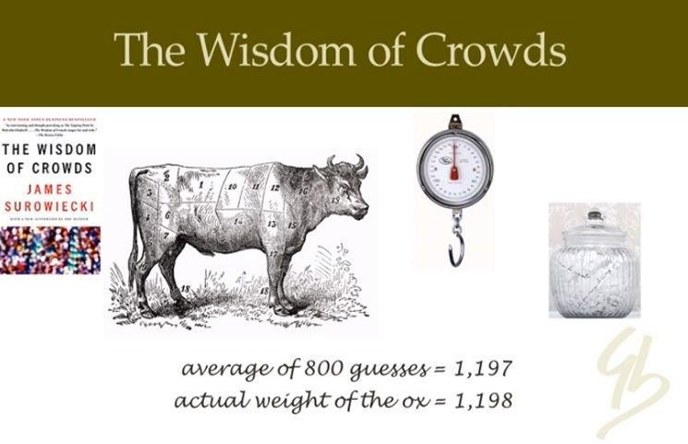
Parable of Ox
🞂​ In 1906, the great statistician Francis Galton observed a
competition to guess the weight of an ox at a country fair.
🞂​ Galton discovered that the average guess (1,197lb) was
extremely close to the actual weight (1,198lb) of the ox.

Slide 14
Use of Mean
🞂​Mean is useful only in the case of ratio scale and interval scale, not useful if the variable is categorical or nominal.

Slide 15
Median (or Mid) Value
🞂​ Median is the value that divides the data into two equal parts, that is, the proportion of observations below median and above median will be 50%.
🞂​ Easiest way to find the median value is by arranging the data in the increasing order and the median is the value at position (n + 1)/2 when n is odd. When n is even, the median is the average value of (n/2)^{th} and (n + 2)/2th observation after arranging the data in the increasing order.

Slide 16
Median Calculation Example
🞂​ The number of deposits in a branch of a bank in a week is Number of deposits in a Bank
Day | 1 | 2 | 3 | 4 | 5 | 6 | 7
Number of Deposits | 245 | 326 | 180 | 226 | 445 | 319 | 260
🞂​The ascending order of the data in Table is given by 180, 226, 245, 260, 319, 326 and 445.
🞂​Now (n + 1)/2 = (8/2) = 4.Thus the median is the 4th value in the data after arranging them in the increasing order; in this case it is 260

Slide 17
Major Difference between Mean and Median
🞂​ Median does not use the values of entire data set, whereas mean is calculated based on the values of the entire data set.
🞂​ Median is more stable for outliers compared to mean.

Slide 18
Mode
🞂​ Mode is the most frequently occurring value in the dataset
🞂​ Mode is the only measure of central tendency which is valid for qualitative (nominal) data since the mean and median for nominal data are meaningless.
🞂​ For example, assume that a customer data with a retailer has the
marital status of customer, namely, (a) Married, (b) Unmarried,
(c) Divorced Male, and (d) Divorced Female. Mean and median are meaningless when we try to use them on a qualitative data such as marital status. On the other hand, mode will capture the customer type in terms of marital status that occurs most frequently in the database

Slide 19
Percentile
🞂​ Percentile, decile and quartile are frequently used to identify the position of the observation in the dataset.
🞂​ Percentile, denoted as P_{x}, is the value of the data at which
x percentage of the data lie below that value
Position corresponding to P_{x} ≈ x (n+1)/100
🞂​P_{x} is the position of the record in the data, where n is the number of observations in the data.

Slide 20
Decile and Quartile
🞂​ Decile corresponds to special values of percentile that divide the data into 10 equal parts. First decile contains first 10% of the data and second decile contains first 20% of the data and so on.
🞂​ Quartile divides the data into 4 equal parts. The first quartile (Q₁) contains first 25% of the data, Q₂ contains 50% of the data and is also the median. Quartile 3 (Q₃) accounts for 75% of the data

Slide 21
Example (Percentile Calculation)
Time between failures of wire-cut (in hours)
2 | 22 | 32 | 39 | 46 | 56 | 76 | 79 | 88 | 93
3 | 24 | 33 | 44 | 46 | 66 | 77 | 79 | 89 | 99
5 | 24 | 34 | 45 | 47 | 67 | 77 | 86 | 89 | 99
9 | 26 | 37 | 45 | 55 | 67 | 78 | 86 | 89 | 99
21 | 31 | 39 | 46 | 56 | 75 | 78 | 87 | 90 | 102
Calculate the mean, median, and mode of time between failures of wire-cuts
The company would like to know by what time 10% (ten percentile or P₁₀) and 90% (ninety percentile or P₉₀) of the wire-cuts will fail?
Calculate the values of P₂₅ and P₇₅.
U Dinesh Kumar, IIM Bangalore

Slide 22
Solution
a) Mean = 57.64, median = 56, and mode = 46
a) Note that the data in Table is arranged in increasing order in columns. The position of P₁₀ = 10 × (51)/100 =
5.1. We can round off 5.1 to its nearest integer which is
5. The corresponding value from table is 21 (10 percentage of observations in Table 2.4 have a value of less than or equal to 21). That is, by 21 hours, 10% of the wire-cuts will fail. In asset management (and reliability theory), this value is called P₁₀ life.

Slide 23
Contd…
Instead of rounding the value obtained from Eq, we can use the following approximation:
P₁₀ = 10 × (51)/100 = 5.1
Value at 5th position is 21. Value at position 5.1 is approximated as 21 + 0.1 × (value at 6th position – value at 5th position) = 21 + 0.1(1) = 21.1
P₉₀ = 90 × 51/100 = 45.9
The value at position 45 is 90 and at position 45.9 is
90 + 0.9 × (3) = 92.7
That is, 90% of the wire-cuts will fail by 92.7 hours

Slide 24
₍₁st
Quartile or Q₁) = 25 × 51/100 = 12.75 ,
^{P}25
Value at 12th position is 33, so
P₂₅ = 33 + 0.75 (value at 13th position – value at 12th position) = 33 + 0.75 (1) = 33.75
P₇₅ (3rd Quartile or Q₃) = 75 × 51/100 = 38.25 Value at 38th position is 86, so
P₇₅ = 86 + 0.25 (value at 39th position – value at 38th position) = 86 + 0.25 (0) = 86

Slide 25
Measures of Variation
🞂​ Predictive analytics techniques such as regression attempt to explain variation in the outcome variable (Y) using predictor variables (X)
🞂​ Variability
measures:
🞂​ Range
in the data is measured using the following
🞂​ Inter-Quartile Distance (IQD)
🞂​ Variance
🞂​ Standard Deviation

Slide 26
Range, IQD and Variance
🞂​ Range is the difference between maximum and minimum value of the data. It captures the data spread.
🞂​ Inter-quartile distance (IQD), also called inter-quartile range (IQR) is a measure of the distance between Quartile 1 (Q₁) and Quartile 3 (Q₃)
🞂​ Variance is a measure of variability in the data from the mean value.Variance for population, σ², is calculated using
n
( X − μ)²
Variance = σ ² =
∑
i=1
i
n

Slide 27
Sample Variance
🞂​In case of a sample, the Sample Variance (S²) is calculated using
−
^{n} ( X − X )
2
S² = ∑
i
i=1
n −1
🞂​ While calculating sample variance S², the sum of squared
deviation
n
⎛
_{− ⎞}2
is divided by (n-1), this is known
∑ ⎜ _{X i}
− X ⎟
⎜
⎟
i =
1⎝ ⎠
as Bessel’s correction.

Slide 28
Degrees of Freedom
🞂​ Degrees of freedom is equal to the number of independent variables in the model (Trochim, 2005). For example, we can create any sample of size n with mean
value of by randomly selecting (n − 1) values. We need
−
X
to fix just one out of n values. Thus the number of independent variables in this case is (n − 1)

Slide 29
Degrees of Freedom
🞂​ Degrees of freedom is defined as the difference between the number of observations in the sample and number of parameters estimated (Walker 1940, Toothaker and Miller, 1996). If there are n observations in the sample and k parameters are estimated from the sample, then the degrees of freedom is (n − k).
−
X

Slide 30
Chebyshev’s Theorem
🞂​ Chebyshev’s theorem (also known as Chebyshev’s inequality) is an empirical rule that allows us to predict proportion of observations that is likely to lie between an interval defined using mean and standard deviation. Probability of finding a randomly selected value in an
interval defined by μ ± kσ is ₁ ₋ ¹ that is
_{k} 2
P(μ − kσ ≤ X ≤ μ + kσ ) ≥ 1 − ¹
_{k} 2

Slide 31
Example 2.2
🞂​ Amount spent per month by a segment of credit card users of a bank has a mean value of 12000 and standard deviation of 2000. Calculate the proportion of customers who are spending between 8000 and 16000?
🞂​ Solution:
P(8000 ≤ X ≤ 16000)=P(μ − 2σ ≤ X ≤ μ + 2σ) ≥ 1 − ¹ = 0.75
₂2
That is, the proportion of customers spending between 8000 and 16000 is at least 0.75 (or 75%)

Slide 32
Skewness
🞂​ The following formula is used usually for a sample with n
observations (Joanes and Gill, 1998):
n(n −1) _{g1}
G₁ =
n − 2
n(n −1)
n − 2
🞂​The value of increases.
will converge to 1 as the value of n

Slide 33
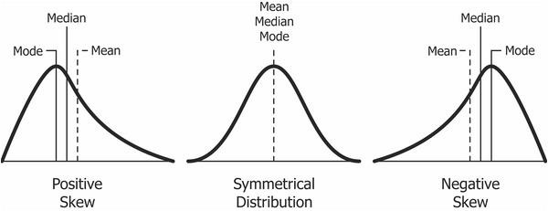
U Dinesh Kumar, IIM Bangalore

Slide 34
Kurtosis
🞂​ Kurtosis is another measure of shape, aimed at shape of the tail, that is, whether the tail of the data distribution is heavy or light. Kurtosis is measured using the following
equation:
4 ⎛
_{− ⎞}4
∑ ⎜ X_{i}
− X ⎟ / n
Kurtosis =
i =1⎝ ⎠
_{σ} 4
🞂​ Kurtosis value of less than
than
3 is called
3 is called
platykurtic leptokurtic
distribution and greater
distribution. The kurtosis value of 3 indicates standard normal distribution (also called mesokurtic)

Slide 35
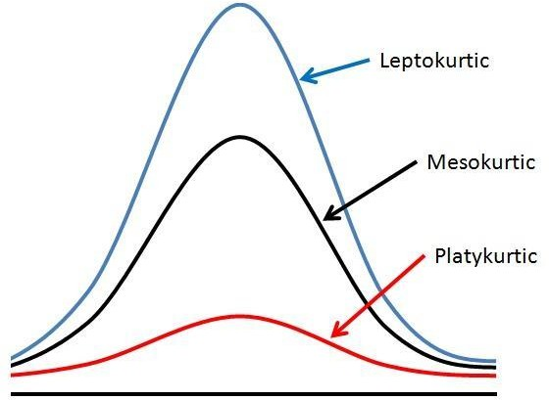
Leptokurtic, mesokurtic, and platykurtic distributions

Slide 36
Excess Kurtosis
🞂​The excess kurtosis is a measure that captures deviation from kurtosis of a normal distribution and is given by:
_{− ⎞}4
4 ⎛
∑ ⎜ X_{i} − X ⎟ / n
i =1⎝
⎠
Excess Kurtosis=
_{σ} 4
− 3

Slide 37
Data Visualization
🞂​ Data visualization is an integral part of descriptive analytics and it assists decision maker with useful insights
🞂​ There are many useful charts such as histogram, bar chart, pie-chart, box-plot that would assist data scientist with visualization of the data

Slide 38
Histogram
🞂​ Histogram is the visual representation of the data which can be used to assess the probability distribution (frequency distribution) of the data
🞂​ Histograms are created for continuous (numerical) data.
🞂​ It is a frequency distribution of data arranged in consecutive and non-overlapping intervals

Slide 39
Steps to construct histograms
Step 1: Divide the data into finite number of non-overlapping and
consecutive bins (interval)
Number of bins, N =
^{X} max ^{− X} min
W
Here X_{max} and X_{min} are the maximum and minimum values of the data and W is desired the width of the bin (interval). Intervals in histograms are usually of equal size
Sturges (1926) proposed the following formula for calculating the number of bins
Number of bins, N =
1+ 3.322log₁₀(n)

Slide 40
Steps to construct histograms
Count the number of observations from the data that fall under each bin (interval).
Create a frequency distribution (bin in the horizontal axis and frequency in the vertical axis) using the information obtained in steps 1 and 2

Slide 41
Use of Histogram
Histogram is very useful since it assists data scientist to identify the following:
🞂​ The shape of the distribution and to assess the probability distribution of the data.
🞂​ Measures of central tendency such median and mode.
🞂​ Measures of variability such as spread.
🞂​ Measure of shape such as skewness

Slide 42
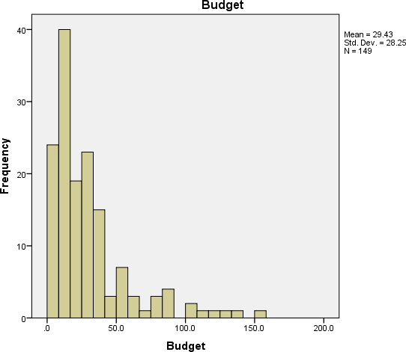
Histogram of Bollywood movie budget

Slide 43
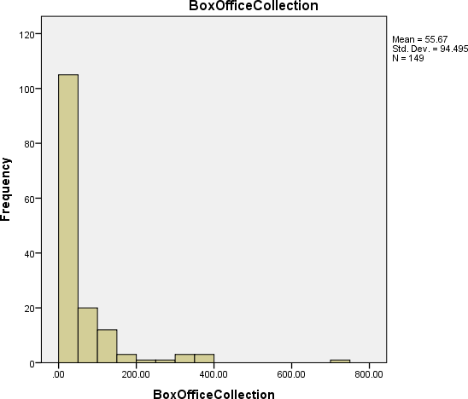
Histogram of Bollywood movie box-office collection

Slide 44
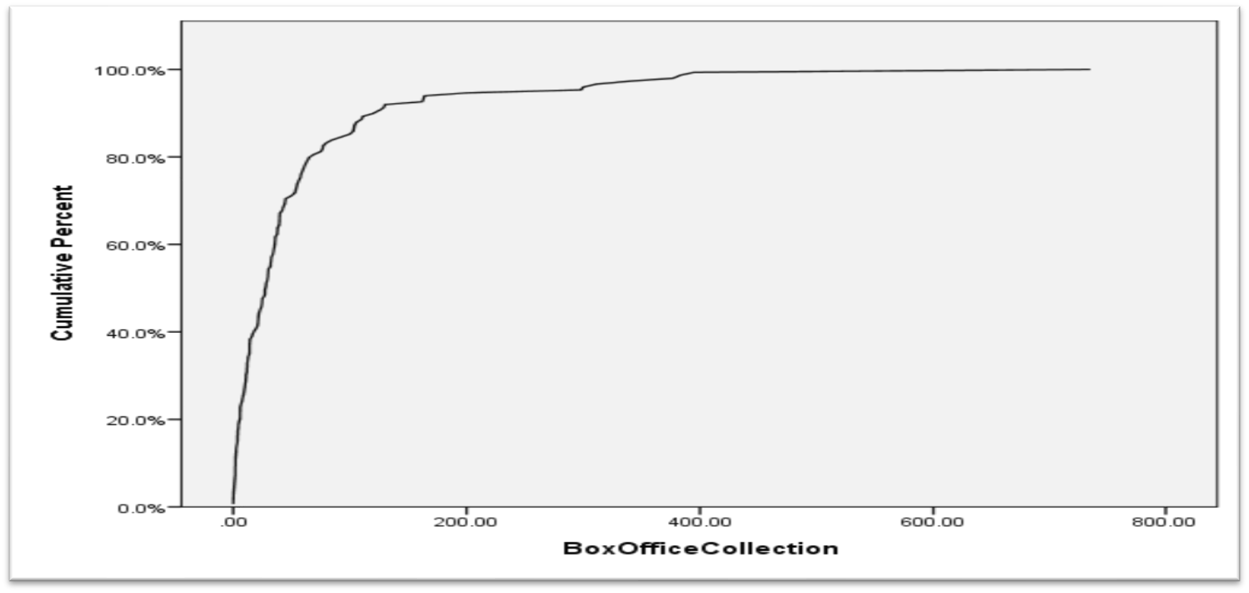
Ogive Curves
🞂​ The cumulative histograms are called Ogive curves. The Ogive curve for Bollywood box-office collection is shown below:

Slide 45
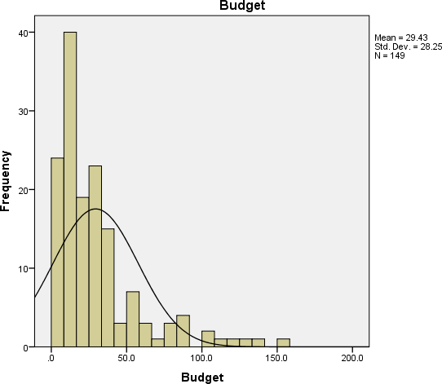
Histogram of Bollywood movie budget along with normal distribution frequency

Slide 46
Bar Chart
🞂​Bar chart is a frequency chart for qualitative variable (or categorical variable)
🞂​Bar chart can be used to assess the most-occurring and least-occurring categories within a dataset
🞂​ Histograms cannot be used when the variable is qualitative

Slide 47
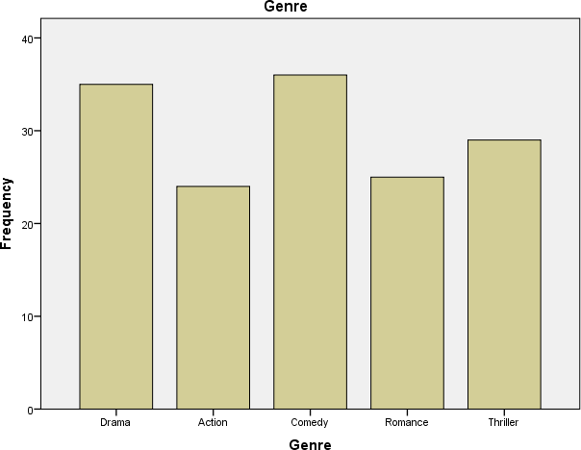
Bar chart for movie genre

Slide 48
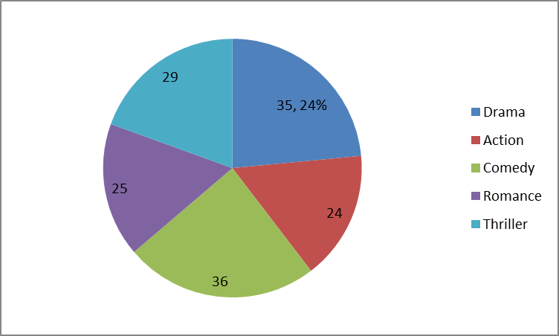
Pie Chart
🞂​Pie chart is mainly used for categorical data and is a circular chart that displays the proportion of each category in the dataset
Pie chart for movie genre

Slide 49
Scatter Plot
🞂​Scatter plot is a plot of two variables that will assist data scientists to understand if there is any relationship between two variables
🞂​ The relationship could be linear or non-linear
🞂​scatter plot is also useful for assessing the strength of the relationship and to find if there are any outliers in the data

Slide 50
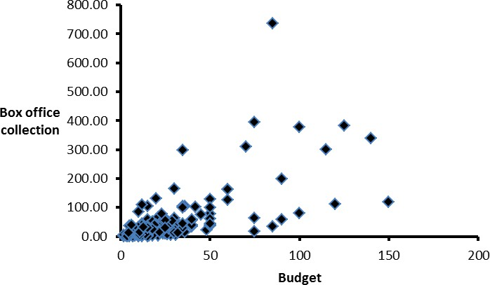
Scatter plot between movie budget and box office collection

Slide 51
Coxcomb Chart
🞂​Coxcomb chart (also known as polar area chart or roses) is an extension of pie chart made popular by Florence Nightingale (Lewi, 2006)
🞂​In a Coxcomb chart, each area represents a magnitude of the category
🞂​The main difference between the regular pie chart and coxcomb chart is that in the case of pie chart the radius of each sector is same, whereas, in coxcomb chart the radius of the sector is adjusted to create the magnitude of the area

Slide 52
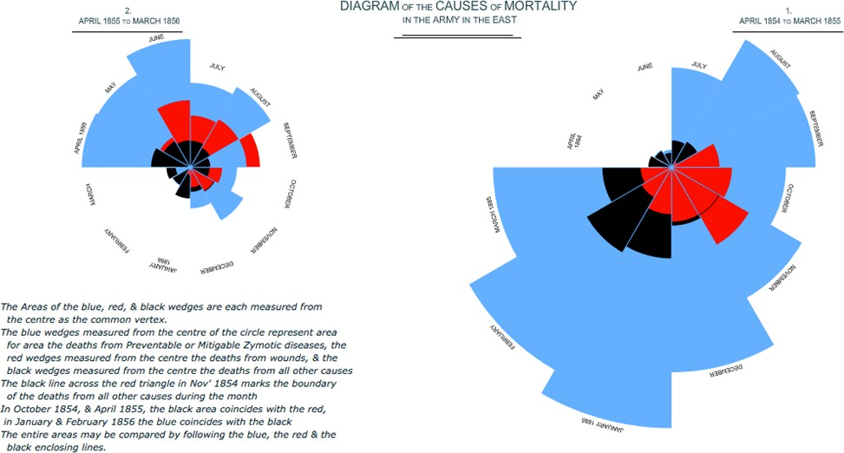
Coxcomb chart on causes of mortality in the army prepared by Florence Nightingale

Slide 53
Box Plot (or Box and Whisker Plot)
🞂​Box plot (aka Box and Whisker plot) is a graphical representation of numerical data that can be used to understand the variability of the data and the existence of outliers
🞂​Box plot is designed by identifying the following descriptive statistics:
🞂​ Lower quartile (1st Quartile), median and upper quartile (3rd
Quartile).
🞂​ Lowest and highest value
🞂​ Inter-quartile range (IQR).

Slide 54
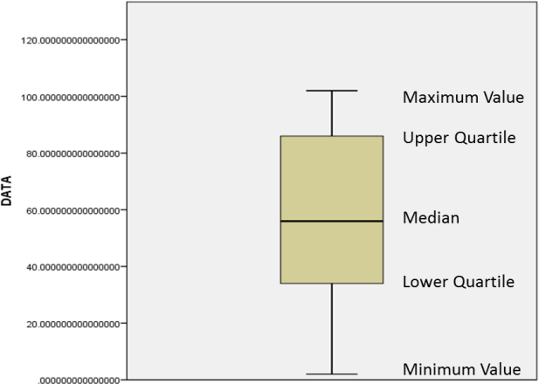
IQR Box Plot
🞂​The box plot is constructed using IQR, minimum and maximum values

Slide 55
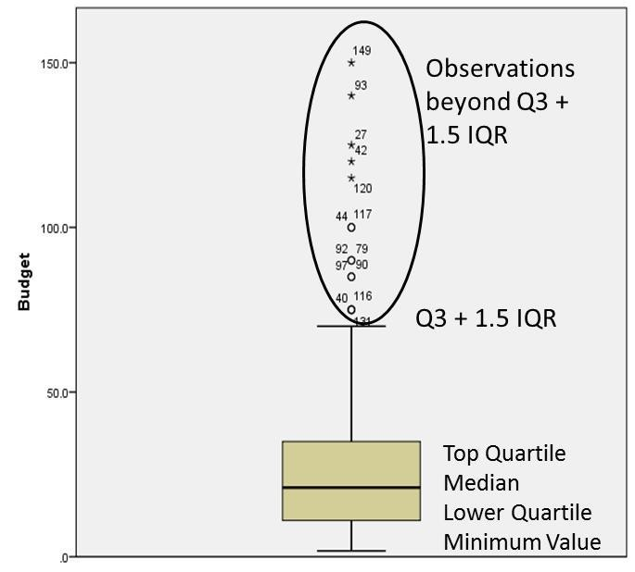
Bollywood movie Budget Boxplot
🞂​ The box plot for the Bollywood movie budget

Slide 56
Treemap
🞂​ Treemap is a hierarchical map made up of nested rectangles frequently used as part of business intelligence reports which helps organizations to understand the data hierarchically
🞂​ The size of rectangle and colour are used for describing/differentiating the characteristics of the data.

Slide 57
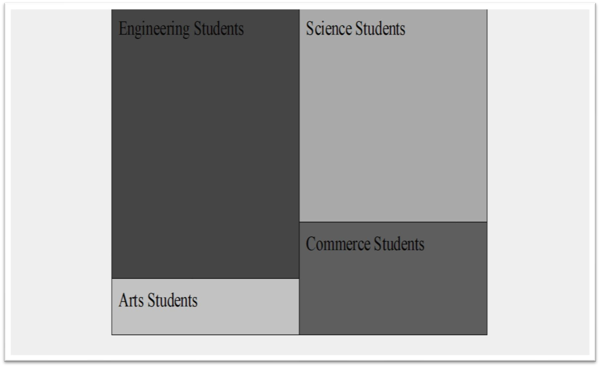
Treemap of student discipline at the undergraduate level

Slide 58
Summary
🞂​ Descriptive analytics is beginning of any analytics project that uses data summarization, descriptive statistics, visualization and queries to gain insights about what happened in the past
🞂​ Measures of central tendency, measures of variation and measures of shape assist data scientists to understand the data for characteristics such as variability and skewness.
🞂​ Descriptive analytics can help data scientists with further analysis of the data by identifying relationships that may exist in the data

Slide 59
Summary
🞂​ Data visualization is an integral part of descriptive analytics and plays a major role in business intelligence (BI) by displaying data using innovative graphs and dashboards for easy comprehension of data to top management.
🞂​ Descriptive analytics will provide hints for developing predictive analytics models.

